Slide 1





EU-Canada Action on
Plastic Waste
Using procurement to reduce plastic waste
MODULE 1
25 NOVEMBER 2022
Jo-Anne St. Godard, Circular Innovation Council
Mervyn Jones, Sustainable Global Resources
DISCLAIMER: The contents of this publication are the sole responsibility of EPRD and its consulting team (Reducing Plastic Waste in Canada) hired to produce these materials and can in no way be taken to reflect the views of the European Union.

Slide 2





EU-Canada Project objective
Boost the ongoing processes towards a circular economy for plastics in Canada by enhancing partnerships and sharing EU strategies, policies and business models as part of addressing marine and freshwater litter regionally and globally.
Policies & regulations
Technology knowledge
Awareness &
communication
Peer-to-peer exchanges on successful policies, best practices and their results.
Business to business exchanges on efficient technologies and market strategies & practices at various scales.
Expand networks and increase exchanges with European governments, businesses and voluntary organizations.
TRAINING: Two modules on circular procurement to reduce plastic waste.
Each module is accompanied by Train the Trainer materials and a Resources pack (this pack includes an Action Plan template, examples of procurement clauses/ checklists/ case studies included in the slides and others).
TRAINING WEBSITE: https://circularprocurement.ca/plastic-resources/
Notes:
Introduce the background to this training:
The EU-Canada Project was launched in 2021. The two-year project Reducing Plastic Waste in Canada will broaden the interactions between Canadian and European decision-makers and influencers in the public, private and non-profit sectors by facilitating peer-to-peer exchanges and supporting the development of knowledge and innovative practices across many sectors of the economy.
The activities will stimulate EU-Canadian collaborations in areas key to a circular economy for plastics, such as:
• extended-producer responsibility
• awareness-raising and consumer education
• best practices and advancement in product design to reduce waste
• innovative and advanced recycling technologies
• business models and policies for value retention
• green and circular procurement practices and tools.
The project is also part of the Program Circular Plastics in the Americas, supporting action and similar exchanges between the European Union and Brazil, Colombia, and Chile, altogether bringing new opportunities for global impact.

Slide 3


Circular procurement to reduce plastic waste
1. Circular economy, procurement and plastics
Aims:
Create a common understanding of the benefits and key success factors of circular procurement relating to plastics waste.
How it supports priority economic, environmental and social outcomes at Federal, Provincial or Municipal level.
Identify key actions/ next steps at policy/ strategy/ process/ capability or other level.
Help those who influence policy, budgets, business case options, market engagement and development within each level of government.
2. Specifying circular outcomes – the procurement toolbox
Aims:
Build confidence in practically using procurement to reduce plastic waste.
Apply through stages of the procurement process and the life cycle of the relevant product/ service or works.
Identify key actions/ next steps for procurement project/ policy/ strategy/ process/ capability or other level.
Help procurement practitioners/ officers with responsibility for developing tenders and managing contracts within each level of government.
Notes:
This training is set up as 2 modules and:
TtT slides and training
Resource pack with action plan, templates, checklists and case studies.
Introduce the broad aims of the 2 modules:
Module 1 – sets the background, how a circular approach to plastics waste reduction and procurement can deliver a range of benefits and supports government objectives (be they national, provincial or municipal), key principles – and identifying a set of key actions to develop capability and plastics waste reduction.
Module 2 – a practical sessions showing how to reduce plastics waste through tenders and procurement projects.
The training will use case studies from Canada and the EU as well as elsewhere, where relevant.
While the modules are an integrated suite of materials and it is recommended that they are taken together, they can stand on their own….
The training will provide the resources, evidence and conceptual framework for participants to build their own action plans and deliver their own training /capacity building etc, as relevant.

Slide 4



Agenda: 1. Circular economy, procurement and plastics
A. The Circular economy - and plastics
B. Circular procurement – key principles, alignment with public sector objectives and the role of procurement in addressing the plastics waste challenge
C. Addressing the plastics challenge through procurement
D. Defining actions - at policy/ strategy/ process/ capability or other level
Notes:
Introduce agenda.
As well as using case studies from Canada and EU, the training will include trainer led and collective discussion:
Polls
Group exercises
Case study discussions
EU lessons
There is also a suite of resources made available as part of the training. These are highlighted on slides and available from the training platform.

Slide 5


Introductions
Your organisation
Your role
What you particularly want to get from this session
Poll
Notes:
Get those attending to introduce themselves.
e.g. their organisation (Federal/ Province or Municipal),
role (procurement practitioner or others who influence policy/ strategy/ budgets etc).
Keep a note of key thing they want to get out of the training and refer back to this during the training – check this has been addressed at the end.

Slide 6
Trainer tips
Tip: Introductions – give everyone the opportunity to introduce themselves and their role briefly. Ask what they want from the session and record so that you can check back at end whether expectations have been met.
(allocate up to 10 minutes)
Timings – this section should take around 20 minutes

Slide 7
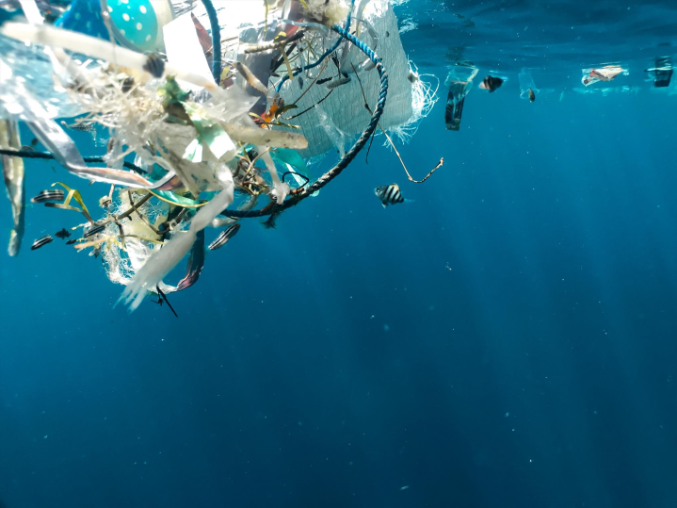
A. The Circular economy and plastics
B. Circular procurement and plastics
C. Addressing the plastics challenge
D. Defining actions
Notes:
This slide format will be used at end of each section within modules to show where delegates are in the training session.

Slide 8
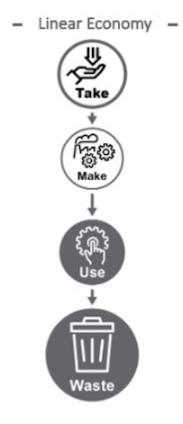
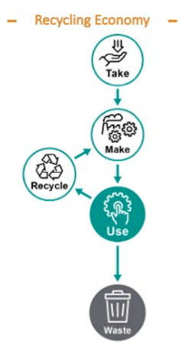
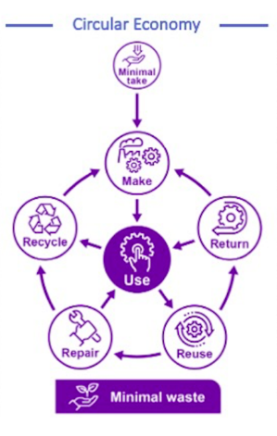
Addressing challenges - delivering environmental, social and economic outcomes
Canada’s CA$7.8 billion lost opportunity (potentially rising to CA$11.1 billion):
87 percent of plastics waste ends up in landfill or the environment*
Of 3.2 Mt of plastic waste in Canada in 2016, just 9% was recycled into new products*
An estimated 10,000 metric tonnes of plastic enter the Great Lakes annually**
OUTCOMES
Socio-Economic
Jobs and skills
Reduced costs
Keeps resources in the economy
Localised supply chains and improved resilience
Innovation & new revenue streams
Encourages public /private partnerships and private sector collaboration
Environmental
Reduced waste & pollution
Reduced reliance on virgin materials
Reduced climate change emissions
Enhanced natural environment
Increased market demand for recycled materials and content
DRIVEN BY DESIGN:
Circulate products and materials (at their highest value)
Eliminate waste and pollution
Regenerate nature
Discussion
*Source: https://www.weforum.org/agenda/2022/01/5-circular-economy-business-models-competitive-advantage/
** https://institute.smartprosperity.ca/sites/default/files/Plastics_Best%20Practices.pdf
Notes:
Start with introducing the linear economy – check that delegates understand this and the problems this brings (see the lost opportunity and where plastics waste ends up).
Explain the recycling economy – how this supports some reduction in waste, but….
Circular economy – explain how this works and the outcomes – not just environmental but economic and social. This puts learning in the context of the challenges that public and private sector organisations face and national or local objectives.
Adopting a circular approach, whereby resources are kept in use for as long as possible, the maximum value is extracted from them whilst in use and then products and materials are recovered and regenerated at the end of a product’s viable life cycle can deliver a range of benefits for:
the environment, by cutting waste, the use of virgin materials and related carbon emissions;
the economy, by improving productivity and opening up new markets, and;
communities, by providing local employment opportunities and lower cost options to access the goods we need.
It also has the potential to help address supply chain disruption – reducing reliance on new materials and products reduces supply chain risks.
Climate Change - link from a focus on circular economy – reducing virgin materials use and reducing waste – reducing carbon emissions. Greenhouse gas emissions are not dropping quickly enough to achieve climate targets and switching to renewable energy can only cut them by 55%. The remaining 45% of emissions come from how we make and use products, and how we produce food. The manufacture and end of life disposal of products, materials or assets bought can involve the generation of significant emissions that contribute to climate change, due to the use of resources, including materials and energy. This is known as Embodied Carbon – reducing this is part of supporting the Circular Economy and addressing Climate Change - Finite resources - Waste
DISCUSSION – ANY FURTHER CHALLENGES/ DO THEY UNDERSTAND THE IMPORTANCE OF SHIFTING TO A CIRCULAR ECONOMY?
Plastic waste and marine litter burdens our economy and threatens the health of the environment including wildlife, rivers, lakes and oceans.
With the longest coastline in the world and one-quarter of the world’s freshwater, Canada has a unique responsibility—and opportunity—to tackle this challenge. By taking urgent action to reduce plastic waste and pollution, we will make our economy stronger and take an important step toward protecting wildlife and the places we love.
It is time to take action! We need to change the way we design, produce, use and dispose of plastics. By working with all levels of government, industry and all Canadians, we can have a zero plastic waste future. Together, we can keep plastics in the economy and out of the environment.
In Canada, the management of plastic waste is a shared responsibility. In 2018, Canada exported just over 100,000 tonnes of its plastic waste to other countries, down from 150,000 tonnes in 2016.

Slide 9
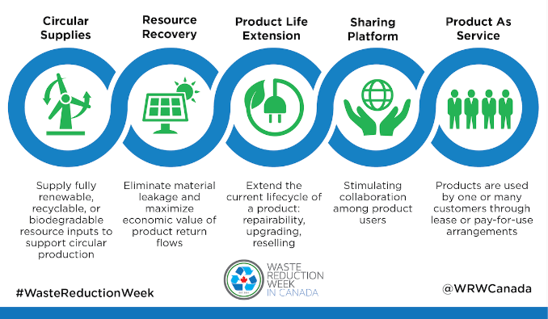
Five business models of circularity
Discussion
Source: https://wrwcanada.com/en/get-involved/resources/circular-economy-themed-resources/five-business-models-circularity
https://www.weforum.org/agenda/2022/01/5-circular-economy-business-models-competitive-advantage/
Notes:
A range of business models that go beyond recycling - to underpin resource efficiency through reduction and reuse.
From World Economic Forum
Circular supplies:
In a circular economy, renewable, recycled, or highly recyclable inputs are used in production processes – enabling partial or total elimination of waste and pollution. Waste becomes an asset, not a liability that you pay to dispose of.
Resource recovery:
Resource recovery focuses on the end stages of the usage cycle, namely the recovery of embedded materials, energy, and resources from products at the end of use that is no longer functional in their current application.
Product life extension:
The born-circular designs their products for repairability, upgradability, reusability, ease of disassembly, reconditioning, and recyclability of all components.
Sharing platform:
Born-circulars maximise how idle assets are used across a community while providing customers with affordable and convenient access to products and services. This also includes sharing industrial assets like a conveyor belt, forklift, machinery and warehouses.
Product as a service:
The customer purchases a service for a limited time while the provider maintains ownership of the product and remains incentivized for the product’s ongoing maintenance, durability, upgrade, and treatment at the end of its use.
We will look at these models in more detail later in this session and in session 2 (case studies and how to apply).
DISCUSSION: Discuss role of new business models. Any experiences – stress that the business model on its own may not deliver circular outcomes – it needs to be built into requirements while the supplier has a potential incentive to extend useful life of products supplied. Discuss examples such as ICT, furniture, textiles, construction – refurb rather than new build, refresh ICT, reuse aggregates etc. Business models that keep products and materials in use, by design, for as long as possible to get the maximum value from them - and therefore reduce waste, the use of natural resources and emissions, and also generate the economic and other benefits considered earlier. There are, increasingly, a number business models available that may be relevant for planned procurements and which represent a focus on the required ‘function’ and alternatives to traditional approaches, including ownership. Some will be familiar, others less so.

Slide 10
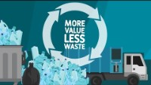
Circular economy and plastics
https://www.youtube.com/watch?v=m9k8A957srw
Notes:
Introduce short video (1:20 minutes) from Environment and Climate Change Canada.

Slide 11
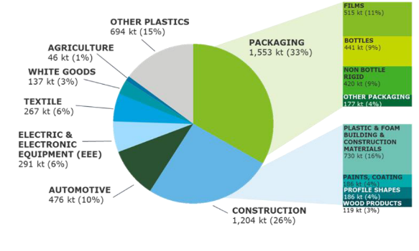





Priorities - plastics use and waste sources
The main generating sectors for plastic waste are (% of total plastic waste):
Packaging (47 percent)
Automotive (9 percent)
Textiles (7 percent)
Electrical and electronic equipment (7 percent)
Construction:
Accounts for 26 percent of plastic put on the market - not yet a large plastic waste generator (5 percent) but this may change.
End-use markets for plastic products in Canada (kt, 2016)
*Source: https://publications.gc.ca/collections/collection_2019/eccc/En4-366-1-2019-eng.pdf
Notes:
This is an important slide as it:
Highlights the priority sectors/ categories where plastics waste arises (it does not relate to procurement as such but identifies priority sectors at a macro-economic level). Module 2 considers procurement specific sectors/categories:
Discuss the main markets for plastic products in Canada (based on 2016 data) - on the left.
The data on the left highlights where waste plastics mainly arises.
The main generating sectors for plastic waste are packaging (47 percent of total plastic waste), automotive (9 percent), textiles (7 percent), and electrical and electronic equipment (EEE 7 percent). The construction sector, while an important end-use market (accounting for 26 percent of plastic put on the market), is not yet a large plastic waste generator (5 percent), given the fairly recent incorporation of plastics in construction (in the 1980s and 90s) that remains ‘stocked’ in houses and buildings; this situation could change in future years with construction renewal.

Slide 12
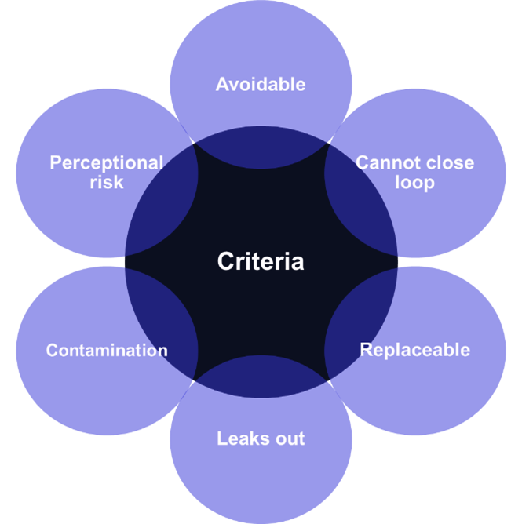
Problematic plastics
Plastic items can become problematic for a number of reasons:
Uncommon material: the polymer (e.g. PVC, EPS and PS) cannot currently be recycled effectively with the existing collection and recycling infrastructure for either technical or economic reasons.
Design: the design and manufacture of plastics items mitigates either effective collection and/or recycling.
Leakage: e.g. through disposal behaviour or mismanagement, e.g. frequently littered.
Recycling: the collection and recycling infrastructure cannot deal with recyclable plastics items because of cross-contamination, size and form etc.
Perception: the plastic item is widely perceived to be a problem e.g. by the public, media, environmental organisations and governments etc.
Source: WRAP & https://www.oneplanetnetwork.org/sites/default/files/from-crm/73239%2520-%2520RWS%2520-%2520Sustainable%2520Public%2520Procurement%2520of%2520Plastics_TG_PDF_A_0.pdf
Notes:
The problem with plastics is that there are so many types and procurers typically purchase products containing plastic rather than the plastic itself.
Most plastics are technically recyclable but whether they are actually recycled depends on a number of factors. Plastics can be problematic for a number of reasons and in some cases, e.g. depending of recycling infrastructure, what is a problem plastic in one place may not be a problem elsewhere. Some factors however, are universally problematic e.g. poor design or composite materials that make even recyclable plastics difficult or impossible to recycle.
Leakage (in the form of macro- and micro-plastics) either through poor management of collection and recycling, or through littering or inadequate collection infrastructure is a key factor.

Slide 13
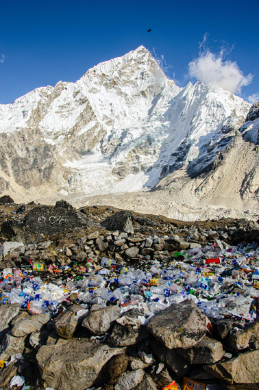
Plastics waste…
How does plastics waste arise?
Pick top 3…
Plastics used where other materials may be more suitable
Single use plastics
Plastics difficult to separate within products
Plastics not recyclable
Plastics within packaging
Plastics not segregated
Unnecessary procurement
Poll
Notes:
Initial icebreaker to get delegates to think about sources of plastics waste.
Ask them to select top 5 ways that plastics waste arises within their organisation from the poll options.
See Slido poll questions and options (incorporated into training materials online).
Discuss after poll what elements are needed to move to more circularity – stress the link to the waste hierarchy.
Reduce use of single use plastics
Products to be designed to be disassembled, to avoid SUPs, to ensure plastics used are easily recyclable
Polymers are in theory recyclable – but products may be difficult to recycle. Recycling plastics is complicated by the variety of chemical compositions of polymers.
Recycling infrastructure to be in place
Cost effective
Compostable plastics
Others…
Beware of unintended consequences.
Recycling label #1 and Label#2 plastic bottles are accepted in nearly all recycling programs across Canada. Although label #6 (polystyrene) plastic – commonly used for coffee cup lids and foam take-out containers - has a recyclable symbol, it is difficult to recycle and Canadian recycling programs do not typically accept it.

Slide 14


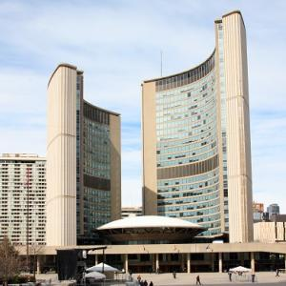

Action at all levels of government
FEDERAL
PROVINCIAL
MUNICIPAL
Federal-Provincial-Territorial initiatives:
Canada-wide Action Plan on Zero Plastic Waste Phase 1 and 2
Sources: images courtesy of Legislative Assembly of Ontario/
https://www.canada.ca/en/services/environment/conservation/sustainability/circular-economy/circular-economy-initiatives.html#toc1
https://ccme.ca/en/res/ccmephase2actionplan_en-external-secured.pdf
Provincial Resources, waste reduction:
https://wrwcanada.com/en/resources/provincial-resources
Notes:
Introduce briefly the measures being taken at government level in Canada to reduce plastics waste – of which this training is part.
While there are different levels of government the actions to reduce plastics waste that can be taken at these levels are broadly the same.
The Canada wide action plan on zero plastic waste has 2 phases:
PHASE 1:
extended producer responsibility.
single-use and disposable products.
national performance requirements and standards.
incentives for a circular economy.
infrastructure and innovation investments.
public procurement and green operations.
PHASE 2:
improve consumer, business and institutional awareness to prevent and manage plastic waste responsibly.
reduce plastic waste and pollution generated by aquatic activities.
advance plastics science to inform decision-making and measure performance over time.
address plastics in the environment through capture and clean-up.
contribute to global action on plastic pollution reduction.
In 2018, the Canadian Plastics Industry Association, the Chemistry Industry Association of Canada and the American Chemistry Council, committed to an interim goal that 100% of plastic packaging be recyclable or recoverable by 2030, with an ultimate goal that 100% of plastic packaging being reused, recycled or recovered by 2040.
It is recognized that plastics waste reduction is an aim of all levels of government in Canada, at Federal level, provinces (e.g. see Provincial Resources link) and municipal.
This supports for example the Federal Sustainable Development Strategy and local government sustainable/ climate strategy and sustainable procurement policies.

Slide 15
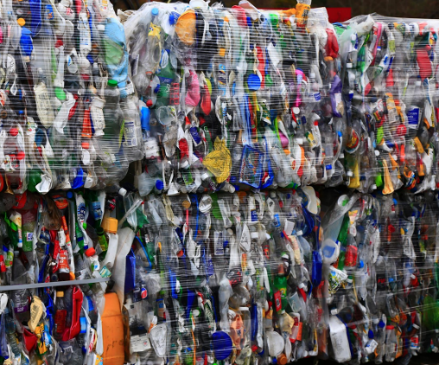
Federal policy – plastics waste reduction
Increase plastic waste diversion; commitment: Divert at least 75% of plastic waste by 2030 from federal operations.
Reduce single-use plastic use in operations, meetings and events; commitment: Eliminate the unnecessary use of single-use plastics in government operations, events and meetings.
Retaining product value: develop a strategy to encourage the remanufacturing of products and other value-retention processes – VRPs – (such as refurbishment, repair and reuse).
Legislation: ban the manufacture and importation of single-use plastics from December 2022*.
Procure sustainable plastics products; commitment: When procuring products that contain plastics, promote the procurement of sustainable plastic products and the reduction of associated plastic packaging waste →
https://www.canada.ca/en/environment-climate-change/news/2022/06/government-of-canada-delivers-on-commitment-to-ban-harmful-single-use-plastics.html
Notes:
A plastic waste target is in line with, and supports, the Greening Government Strategy commitment to “divert at least 75% by weight of all non-hazardous operational waste by 2030.” This target will support the Ocean Plastics Charter commitments to increase the efficient use of resources while strengthening waste diversion systems and infrastructure to collect and process plastic materials.
Single-use plastic items, such as disposable straws, utensils, beverage bottles, disposable hot and cold drink cups, and plastic bags, are a visible component of the plastic waste stream and constitute a significant portion of the plastic litter in terrestrial and marine environments and can be difficult to collect and recycle. Single-use plastics may sometimes be necessary for accessibility, health, safety or security reasons, in many situations they can be avoided entirely or replaced by more reusable, compostable or recyclable alternatives.
To learn more, read the Guidance for the Reduction of Plastic Waste in Meetings and Events.
Public procurement can support markets for more sustainable plastics products, such as reused, repaired, remanufactured or refurbished, and made with recycled plastic content, or be readily recycled or composted at their end of life.
The government approach for these initiatives will take into consideration the availability of plastic waste recycling and diversion options, health, accessibility, and national safety and security exemptions.
The ban includes checkout bags, cutlery, straws and food-service ware made from or containing plastics that are hard to recycle, with a few exceptions for medical reasons.
It will come into effect in December 2022, and the sale of those plastic items will be prohibited as of December 2023, the government said.
Priority actions will include the implementation of Extended Producer Responsibility programmes, strengthening of disposable plastic product management, creation of national performance requirements and standards and incentives for a circular economy, development of infrastructure and innovation investments, and public procurement and green operations.
Also mention Canada Plastics Pact - https://roadmap.plasticspact.ca/wp-content/uploads/2021/10/CPP_Roadmap_V1_Oct2021.pdf
Canada Plastics Pact:
1 plastics packaging represents nearly 50% of the plastics produced in Canada each year;
2 after it’s short first-use cycle, an estimated 95% of plastics packaging material value is lost;
3 there is both a clear path and momentum from key businesses, governments and organizations across Canada for addressing the challenge of plastics packaging.
4 targets:
Define a list of plastic packaging that is to be designated as problematic or unnecessary and take measures to eliminate them by 2025.
Support efforts towards 100% of plastic packaging being designed to be reusable, recyclable or compostable by 2025.
Undertake ambitious actions to ensure that at least 50% of plastic packaging is effectively recycled or composted by 2025.
Ensure an average of at least 30% recycled content across all plastic packaging (by weight) by 2025.

Slide 16
Trainer tips
Allocate short time to discussions (ca 5 minutes) due to length of module
Poll – you could use an online poll tool (e.g. Teams, Zoom, Mentimeter, Slido etc) that records the output or simply use chat function (if online) or hands (if face-2-face
Resource slides – these are hidden but you can show them and/or refer to them as additional resources for learning outside of the Module training.
  Reference the resource materials website if you do.
Timings – this section should take around 30 minutes

Slide 17

A. The Circular economy and plastics
B. Circular procurement – aligning with public sector objectives, key principles and role of procurement in addressing the plastics waste challenge
C. Addressing the plastics challenge
D. Defining actions
Notes:
Set out how the first section set the scene for the role of procurement in delivering plastics waste reduction.

Slide 18

The ‘Golden Thread’ - The power of procurement to deliver a circular economy
UN SDGs
Federal
Action Plan for the Canada-wide Strategy for Zero Plastic Waste
Enabling mechanism to support the transition to a circular economy, including reducing plastics waste.
Mobilising procurement and supply chains to:
maximise the lifespan and value of materials, products and assets, and
realize the environmental, economic and social improvement all levels of government seek.
Provincial
Organizational economic, social and environmental objectives
Municipal
Sustainable procurement
Your plastics waste reduction action plan – applying circular approaches
Contracts/ Frameworks
Relevant and proportionate requirements
Notes:
Alignment of Federal SD Strategy and Greening Gov Commitments with UN SDGs – the national action plan for zero plastic waste – provincial and municipal economic, social and environmental objectives.
These will be supported by a focus on sustainable /green procurement (e.g. provinces and municipalities will have sustainable procurement policies – these may be old/ not reference plastics specifically but they set out the commitment to reducing emissions and waste). All provinces and many municipalities have sustainable/ green procurement policies and will have a commitment to reduce plastics waste – procurement is an essential mechanism to help achieve this.
Discuss with delegates the aim that by the end of this training they will be able to develop an action plan to best focus on reduction in plastics waste through procurement.

Slide 19





Key success factors
SET AMBITIONS - policy objective, targets and buy-in to circular approach; focus on priorities.
CONSIDER ALTERNATIVES - Be prepared to consider alternatives to business as usual – asking ‘Why?’
START EARLY - Make the right choices early on in the procurement process.
COLLABORATION IS KEY - Maximise opportunities by collaborating internally, with markets and peers.
Notes:
Introduce the key principles when applying circular approaches:
Set ambitions – ensure policies commit to plastics waste reduction and set ambitions; ensure this clearly sets out the role of procurement and a focus on priorities (such as those sectors/ categories shown above).
Consider alternatives – ensure the environment is in place to consider alternatives to the norm/ what has historically been procured; challenge in a positive way the norm and ask ‘Why’ do we procure what we do. Is there a better way of delivering the required function.
Start early – making the right choices means early consideration in conjunction with key stakeholders.
Collaboration – with key internal, external and market stakeholders.
These are considered in more detail below.

Slide 20

Setting ambitions: Objective setting
 | Present | Future
Value Drivers | Cost Savings and Risk Mitigation | Carbon and policy delivery mechanism
Procurement’s Role | Sourcing (operational) | Strategic as well as operational
Business Role | Procurement Customer | ‘Intelligent’ client
Delivery Model | Standalone Corporate Function | Integrated category management approach
Resources | Execution Staff and Core Experts | Embedded capability across whole procurement cycle
Notes:
General approach to objective setting but remind participants that objectives around plastics need to be integrated with wider procurement objectives and corporate sustainability and circular goals.
Broad Procurement Objective 1: VALUE DRIVERS
Cost Savings and Risk Mitigation are usually the two major value drivers. Smart procurement will adopt technologies for insights into supply market, supplier performance, and business buying behaviour.
The shift in this objective from Cost Savings & Mitigation to a Carbon and policy delivery mechanism implies leveraging procurement insight about spends, suppliers, and markets to identify new sources of value generation. Better data means procurement can also fulfil its role in supplier relationship and risk management.
Procurement Objective 2: PROCUREMENT’S ROLE
Secondly commissioners should transform to sourcing advisors. At present, if an organization’s procurement team is limited to sourcing as instructed then there is little scope for strategic procurement to deliver better outcomes.
This shift requires skills and training around the links with other policy objectives e.g. carbon. Category managers can focus on the top-tier purchases while developing newer strategies in category management.
Procurement Objective 3: BUSINESS ROLE
The third change in paradigm is that of the role businesses are to play. So far, the procurement function has been a simple vehicle to fulfil a business requirement. But a smarter procurement objective wherein procurement will act as a disciplined sourcing agent to other functions offers better outcomes. This entails greater responsibility in making the right sourcing decision, ownership of consequences, and vendor relationship management.
Procurement Objective 4: DELIVERY MODEL
The fourth procurement objective is a transition; from a standalone corporate function to a integrated category management approach wherein the category managers will define the scope, strategy and policy delivery in major purchases while the remaining procurement would provide purchasing assistance to the business.
This new delivery model implies less transactional work and increased business-partner management. This implies a greater focus on process excellence than limiting to category knowledge (current objective) and enforcement of sourcing discipline.
Procurement Objective 5: RESOURCES
Broadening responsibility for procurement based outcomes will help embed capability across the whole procurement cycle and bring utilisation and responsibility for end-of-life decisions into play earlier within the organisation.
Understand your procurement impacts and review against need
Set measurable long-term goals supported by practical actions
Inform others internally and externally of their role (RACI)
Use a mix of near-term solutions to create momentum and mitigate risks.
Keep abreast of innovation and options through market engagement

Slide 21
Circular procurement – delivering positive outcomes
PRINCIPLE | CIRCULAR PROCUREMENT ACTION
AVOID | Avoid new products Reconsider ownership Fewer products
LIFETIME OPTIMISATION | Optimise utilization of existing assets Repair existing products Reuse-internally or externally
LIFETIME EXTENSION | Remanufacture Design for deconstruction/ disassembly End of life collection
CLOSE LOOPS | Recycle materials Displace virgin materials Reduce Landfill
INTERNAL BENEFITS | WIDER BENEFITS
Retaining assets longer to reduce costs | Reduced virgin non-renewable material use
Reduced plastics waste | Closing product and material loops to reduce waste and associated carbon emissions
Improved resource efficiency | Reducing wider environmental impacts
Lower greenhouse gas emissions | More sustainable consumption and production
Improved and market leading performance | Increased whole life value
Taking control of sustainability outcomes | More resilient growth
Balance across triple bottom line | New (Green) training & job opportunities throughout the supply chain
Robust framework to ensure partners aligned with organizational aims
Improved reputation | Increased social value
Notes:
This slide emphasises the circular procurement principles (or strategies) of:
Avoid
Lifetime Optimisation –
Lifetime Extension
Close Loops.
Explain what they mean and what benefits can arise internally and more widely.

Slide 22
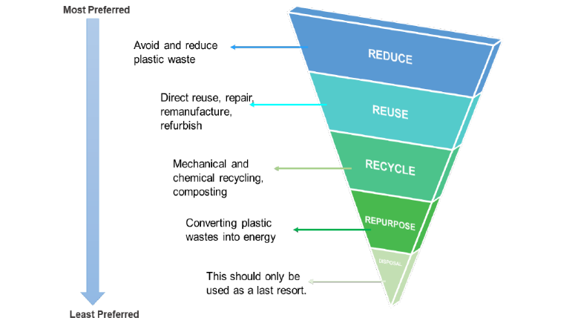
Resource
Hierarchy of priority in plastics management
Value retained
Value lost
Source: Modified by Canadian Energy Research Institute and from https://ccme.ca/en/res/strategyonzeroplasticwaste.pdf
Notes:
Using procurement as enabling mechanism to reduce waste. This means applying a hierarchy approach as above.
Reducing demand for conventional, virgin plastics
Expanding waste management capacity by deploying sustainable waste infrastructure to handle current volumes sustainably.
Both strategies can be fostered through one public sector instrument: public procurement. To implement the waste reduction targets, public procurement plays an important role in creating opportunities for municipalities and their capacities to realize the new circular economy.
Various stages of the public procurement cycle can be tweaked to reduce the generation of plastic waste.
This ranges from prioritizing recyclable products as well as products with remanufactured or refurbished elements, through defining specifications that encourage the use of plastic substitutes, to favouring holistic business models that complement product delivery by waste reduction services during the use and end-of-life phases.
Beyond tenders for circular goods and services, the public sector will need to invest in appropriate infrastructure to divert waste streams and create feedback mechanisms to “close the loops” for the circular economy.
Adopting a circular approach, whereby resources are kept in use for as long as possible, the maximum value is extracted from them whilst in use and then products and materials are recovered and regenerated at the end of a product’s viable life cycle can deliver a range of benefits for:
the environment, by cutting waste, the use of virgin materials and related carbon emissions;
the economy, by improving productivity and opening up new markets, and;
communities, by providing local employment opportunities and lower cost options to access the goods we need.
It also has the potential to help address supply chain disruption – reducing reliance on new materials and products reduces supply chain risks.
Circular approaches can therefore be part of the solution to addressing the climate emergency

Slide 23
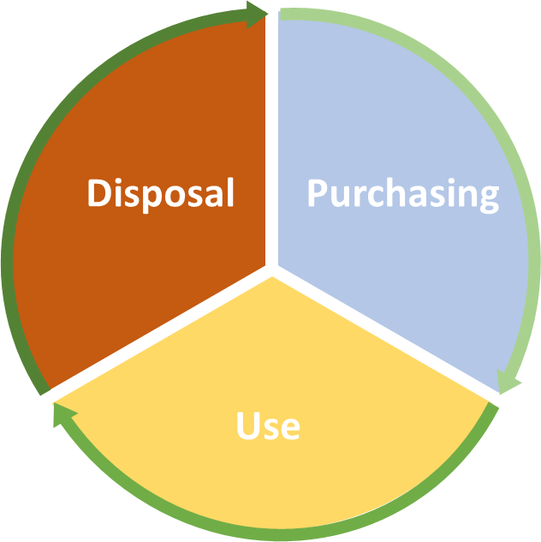

Considering the full life cycle
Circular procurement addresses all stages of product lifecycle:
Where does it come from?
End of Life
Source
Who made it?
What is it made of?
Use
How will it be used?
EoL
What will happen to it?
Notes:
Circular procurement lifecycle principles are about asking simple questions early on in the procurement cycle. Setting objectives and ambitions means applying a life cycle approach.
Following the procurement lifecycle stages, particularly around rethinking the need to buy at all (e.g. are there alternative circular business models to ownership), then addressing the five key questions across the whole product / service lifecycle will enable a more circular outcome and identify potential for savings.
It is important to consider the life cycle of the product/ service or works so that opportunities for plastics waste reduction can be identified.
Introduce link between achieving different goals and the lifecycle of a device. Think about impacts across whole life cycle as early as possible.
Consideration at initial purchase will help in the procurement of repair and maintenance services as well as waste management/end of life services at end of life, according to ownership decisions.
Keep resources in use for as long as possible.
Extract maximum value from them whilst in use.
At the end of a product, material or asset’s viable life cycle they are recovered and regenerated.
Closing energy and material loops at the maximum value within supply chains across whole life cycle.
Introduce Life Cycle Impact Mapping as a tool (it can be simple as well as more complex depending on the approach taken) that could be used to start the consideration of risks and opportunities.

Slide 24

The City of Toronto
Circular procurement commitment
Background: In 2016, the City Council approved the Long-Term Waste Management Strategy and formed a Cross-Divisional Circular Economy Working Group to apply circular economy principles to the city’s procurement processes.
Actions: The Circular Economy Procurement Implementation Plan and Framework is the City’s tool to leverage the purchasing power to drive waste reduction, economic growth, and social prosperity through a circular economy approach.
Impacts: Since inception, the project has launched the pilot phase and has begun to identify existing circular procurement activities and integrate new requirements within call documents.
Barriers overcome & Lessons: The Framework helps the city to drive circular economy innovation and implementation while generating a broad range of societal benefits through its procurement practices.
Example
Source: Circular economy procurement plan and framework: Toronto (ellenmacarthurfoundation.org)
Notes:
The City of Toronto’s development of circular procurement principles with support from the Circular Innovation Council and Dutch government has now been recognised by the Ellen MacArthur Foundation as a global case study. Circular economy procurement plan and framework: Toronto (ellenmacarthurfoundation.org)

Slide 25

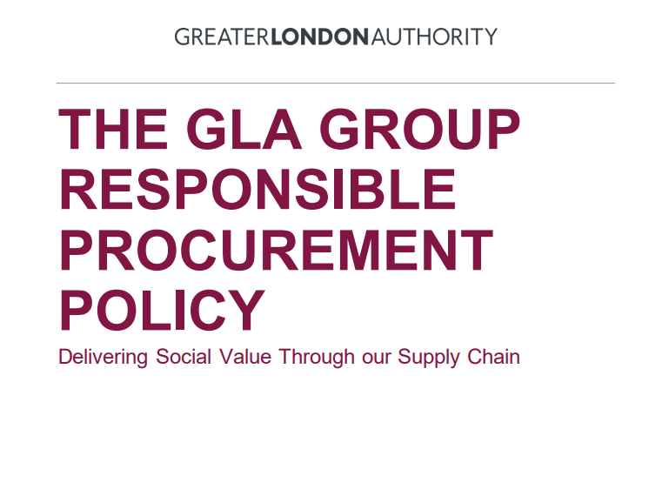
Circular procurement commitment within responsible procurement policy
Extract from Responsible Procurement Policy March 2021
‘Giving priority to circular procurement options and business models that maximise value from products and services for as long as possible, keep long term expenditure down, use sustainable materials, and reduce financial and asset disposal risks.
We will encourage and trial materials innovation to keep materials in circulation for longer to reduce consumption of resources and reduce the usage of disposable products, particularly single-use plastics.’
Example
Source: https://www.london.gov.uk/sites/default/files/gla_group_responsible_procurement_policy_2021.pdf
Notes:
Discuss how does this reduce plastics waste?
Ensuring plastics waste that would otherwise enter waste stream can be recycled.
Discuss with delegates the above example and the extent or otherwise to which it gets to the root cause of the problem.

Slide 26

Why?
Consider alternatives: asking ‘Why?’
Why do we procure what we do?
What alternatives are there we should consider, that may deliver the required function and reduce plastics waste?
Have we considered this with key stakeholders and the market?
Does this include alternatives to ownership?
How will it be used and what will happen to it afterwards?
Is an innovative solution needed?
Notes:
Stress the importance of considering alternatives and not defaulting to historic procurement without asking ‘Why?’
It is recognised that this needs to involve key stakeholders – for example finance (as some choices may mean shifting from capital to revenue budgets and it is important to understand the full life cycle costs of planned procurements e.g. waste costs that may be within someone else’s budget or fall in some time to come).

Slide 27




Alternative innovative solutions
Canadian Plastics Innovation Challenges – Environment and Climate Change Canada
Is there an ‘unmet need’ regarding plastics waste reduction?
Are improvements in products, materials or services possible?
Are the conditions for innovation in place within the public body?
‘Ask a smart question – get a smart answer’ – let the market propose ideas.
Plastics Challenges:
Find sustainable alternatives to plastic packaging
Reduce plastic waste from textiles
Divert end-of-life vehicles’ plastic from landfills
Reduce e-waste
Monitor microplastics in marine environments
Recycling plastic into ceiling tiles
Source:
https://plasticactioncentre.ca/directory/industry-plastics-initiatives/
https://greenmantra.com/
https://www.canada.ca/en/environment-climate-change/news/2021/03/canadian-plastics-innovation-challenges--environment-and-climate-change-canada-phase-1-recipients.html
Notes:
Innovation is an important element of the shift to a circular economy and plastics waste reduction.
This includes:
Canadian Plastics Innovation Challenges – Environment and Climate Change Canada
Other examples include Canadian Ontario example GreenMantra (https://greenmantra.com/) and the Scottish example MacRebur plastic and aggregate mix (https://macrebur.com/) – waste plastics is added to aggregate mix (improves structure and bonding). How circular is this, given that it is taking waste plastics and reusing it, with limited ability to extract value when road is re-laid? Does it reduce plastic waste?
In reality this is one of many solutions needed.

Slide 28
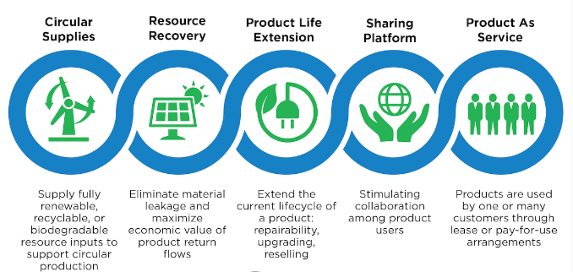
DESIGN
RE-USE & REPAIR
REMANUFACTURING & RE-USE
CIRCULAR BUSINESS MODELS
RECYCLING
Circular Suppliers
Businesses may be able to apply various approaches that support the transition to a circular economy and reduce plastics waste.
Buyers:
Consider, for example, the pros and cons of circular business models early in the commissioning and procurement process, and not automatically default to historic purchasing.
Suppliers:
Consider the role and implications of these business models in their business planning and supply offering.
Notes:
Buyers must understand the maturity of markets regarding circularity and how they may reduce plastics waste. This includes:
Design
Products are made using regenerative materials and modular design techniques in order to be longer-lasting and easier to disassemble and repair, in essence, to design out waste.
Re-use and repair
Product life cycles are extended by maintenance and repair, so they remain in their original use for as long as possible. This could include manufacturers retaining ownership of their products and implementing re-use and repair services.
Remanufacturing and Reuse
Extending the lifetime of products at the end of their ‘first life’ by repurposing them or enabling other, subsequent uses.
Recycling
Products can be easily separated into component parts and materials, enabling reprocessing of existing materials in new products, retaining value and displacing the use of virgin raw materials.
Circular Business Models which may include ownership remaining with the supplier/ manufacturer – enabling greater control over the production and management of a product or asset, and therefore a built in incentive to produce a product or asset that lasts. More details are provided later in this module.

Slide 29



Electrical and electronic equipment
Circular approaches to plastics waste – Lifetime optimization & extension
Refurbishing equipment for reuse by schools across Canada.
http://www.ic.gc.ca/eic/site/cfs-ope.nsf/eng/home
Equipment in working condition can be sold for reuse to the public.
Example
https://www.gcsurplus.ca/mn-eng.cfm
Notes:
CFS+ is a community based programme from the Government Innovation, Science and Economic Development Canada ( ISED ) which works with Canadians in all areas of the economy and in all parts of the country.
GC Surplus sells surplus federal government assets such as furniture, cars, trucks, boats, farm equipment, and large-volume materials, such as metal, wood, or textiles. It doesn’t sell used computer and electronic equipment yet.
Discuss how does this reduce plastics waste?
Avoids otherwise redundant items entering waste streams. Extends product lifetimes. Displaces virgin materials and associated energy costs.
Social value – skills and job opportunities.

Slide 30



Packaging
Circular approaches to plastics waste – Innovative ‘closing the loop’
USABLE PACKAGING
Bioplastics for the Circular Economy
The Usable Packaging project – funded under the European Union’s Horizon 2020 Research and Innovation programme – aims to reduce the use of environmentally harmful fossil-fuel-based packaging by developing “high-performance” bio-alternatives derived from food industry by-products, to cover packaging and product needs for the food, drinks, pharmaceutical and clothing industries.
Recommendations (not yet EU policy) include:
Mandating the obligatory use of biobased and compostable materials in applications where traditional plastics can only ever be contaminants.
Promoting policies which ensure market space for innovation in materials manufacture.
Example
Source:
https://www.circularonline.co.uk/news/usable-packaging-project-submits-seven-point-strategy-for-european-institutions/
Finnish Bioeconomy Strategy: https://www.bioeconomy.fi/facts-and-contacts/the-finnish-bioeconomy-strategy/
Notes:
Discuss how does this reduce plastics waste? E.g. substitution and reducing dependency on fossil-based plastics.
Innovation in bio-based and compostable materials to reduce embodied carbon within packaging/ avoid waste through composting.

Slide 31
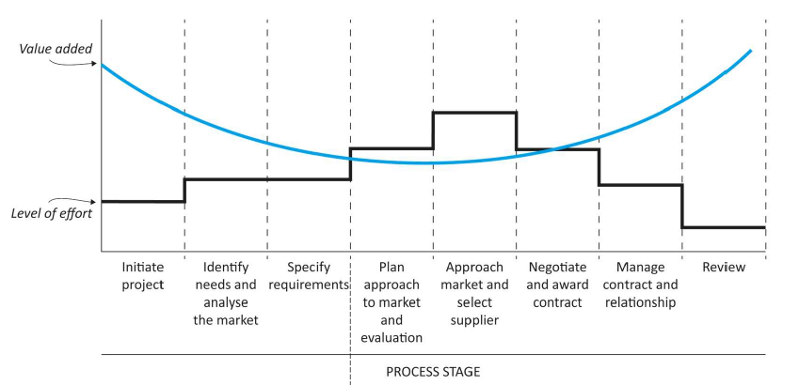
Start early – collaboration is key
Value added
Engagement
Internal
With the market
Level of effort
With other
public sector
strategic stage
operational stage
Challenge need – eliminate or reduce consumption
Challenge requirements – specification
/ alternative solutions
Technical and Service Specifications
Selection Criteria
Method Statements
Terms and Conditions
Added Social Value (TOMS)
Performance Measures / KPIs
What We Buy
How We Buy
Choice of Procedure
Output / Outcome focused
Notes:
This slide shows that in terms of resource effort, most is commonly focussed on the tender stages where value added is least but effort is greatest. Effort up front can also potentially reduce time in tender stages.
It is another way of presenting the earlier fishtail slide shown in module 1 but also highlights that contract management is typically poorly resourced but high in value add.
The key question for the public sector bodies is how is this resource allocated? Is it procurement teams or the departments responsibility?
Consideration at the earliest opportunity is essential if greatest gains are to be made.
Collaboration is key:
internally,
with markets,
with peers.
to understand opportunities for delivering the optimum solution.

Slide 32


Reinforced in ‘Circular procurement in 8 steps’
From definition to ambition
Internal organisation
Defining your need
Business models
Market collaboration
Tender procedure
Evaluating and awarding
Contract management
Pre-tender
Tender
Source: https://www.copper8.com/wp-content/uploads/2018/10/Circular-Procurement-in-8-steps-Ebook.pdf
Notes:
In practice this reflects the emphasis placed on early (pre-tender) consideration and planning with internal and external stakeholders.
First 5 are effectively strategic actions to be considered in pre-tender phase
Last 3 are operational actions to be considered in tender and post-tender phase
A free online guide was published as part of European commission funded project and explains each step in detail with illustrations from real world circular procurement case studies.

Slide 33
Trainer tips
Examples – depending on pace these case study examples can be added to using the additional slides in the resource pack (reference the resource materials website) or deleted (if not enough time).
  Alternatively if you have your own local examples swap these in.
  Note that examples typically address more than one circular theme so emphasises the aspects most relevant to the Section but remind audience that a circular approach is systemic and so delivers multiple benefits.
Resource slides – these are hidden but you can show them and/or refer to them as additional resources for learning outside of the Module training.
  Reference the resource materials website if you do.
Timings – this section should take around 30 minutes

Slide 34

Give exact time for return
LUNCH BREAK – please be back in 30 minutes
Notes:
Lunch Break
Note this can be moved to a more appropriate place if required and shortened to a comfort break if necessary – however a minimum of 10 minutes is recommended.

Slide 35

A. The Circular economy and plastics
B. Circular procurement and plastics
C. Addressing the plastics challenge
D. Defining actions
Notes:
Highlight where we are in the session, having considered the role of procurement – we need to consider challenges that exist, where plastics exists within planned procurements and strategies to focus on reducing plastics waste.

Slide 36
Let’s deal with challenges (to the plastics challenge)…
Actual | Perceived
Not being considered early enough by the right people? | Better recycling is the answer?
Alternatives to historic procurement not considered? | Buy-in – ‘Canada is an insignificant contributor to the global plastics problem - banning single-use plastics will harm consumers.’
Limited examples in Canada? | Trade agreements and procurement uncertainty?
Buyers may not encourage and enable innovation? | Others?
Resources and local constraints?
Strategic?
Others?
Notes:
These are some challenges buyers may face – they may be actual challenges as a result of systems/ process/ culture or those that are perceived such as the perception that plastics waste in Canada is not a significant problem – which this training has shown is not the case.
Addressing challenges during strategic planning.
Describe the 4 generic challenges to strategic planning:
1. Lack of ownership
An effective strategy requires cross-departmental and cross-functional feedback from across the organization.
2. Poor communication
Poor communication is at the crux of most problems - both business and personal. Effective collaboration is one of the most critical and challenging parts of the strategic planning process.
3. Lack of alignment
Even the most well-executed strategic plan won't be useful without strategic alignment. A lack of representation from across the organization is one of the primary causes of poor strategic alignment.
4. Slow adoption
If teams are slow to adopt the plan, it will quickly become outdated and irrelevant to everyday processes and priorities.

Slide 37
Green procurement and International Trade Agreements
The World Trade Organization (WTO) Agreement on Government Procurement (GPA)
As a party to the GPA, Canada is committed to:
  non-discriminatory, fair and transparent conditions of competition in government procurement
  ensuring that our approach to green procurement remains consistent with our obligations under the GPA.
The GPA does not prevent Parties from implementing green procurement policies, as long as it is not done in a discriminatory fashion or as a disguised restriction on international trade.
The GPA contains provisions that enable Parties to include environmental considerations in procurement processes.
Notes:
THIS SLIDE IS IMPORTANT IN THE CONTEXT OF MYTH BUSTING BARRIERS TO ADOPTING NEW SUSTANABILITY PRACTICES.
There may also be the perception among government buyers or other stakeholders that International Trade Agreements in effect preclude consideration of sustainability (and therefore plastics waste reduction) though procurement.
As this slide highlights this is not the case – as long as green procurement policies are not done in a discriminatory fashion or as a disguised restriction on international trade then this is permitted (in practice all levels of government in Canada have commitments to sustainable procurement).
In conclusion: there is no impediment to green public procurement from international trade agreements (as European examples demonstrate).

Slide 38

Aim for 20 minutes including 5 minutes feedback
Addressing actual & perceived challenges
In your group, consider:
What are the challenges you face/ feel others face in reducing plastics waste from procurement?
What solutions exist/ have been used/ could be developed – share lessons?
Breakout Groups
Notes:
In groups facilitate discussion about challenges faced in reducing plastics waste through procurement – actual and perceived.
Get someone to record answers and to present brief feedback
What are the challenges they face/ feel others face?
What solutions exist/ have been used – share lessons.

Slide 39

Plastics and procurement – where is it?
Are you procuring plastics?
Are you procuring products and packaging (or services which use products or packaging) which contain plastics?
Discussion
Notes:
Having considered the role of procurement, addressed challenges that exist – it is important to be clear where plastics exists within procurement. Procurers rarely procure plastics directly (likely to be limited) most likely, they procure plastics within products/ packaging/ services/ works.
We have previously considered priority sectors/ categories – an analysis of procurement categories/ planned procurements (forward plans or equivalent) helps identify hotspots to focus on – for example undertaking self assessment of spend categories against relevant plastics use and waste criteria.

Slide 40

Procuring plastics
Key questions:
Avoidance
Substitution
Recyclability
Collection
Recycling
fossil to fossil
fossil to bioplastic
fossil to non-plastic
household
on the go
commercial
Can you switch material type?
Where is the plastic waste collected?
necessary
unnecessary e.g. alternative available
recycled polymer locally
currently not recycled locally
fully
recycled
EfW
landfill
Can you avoid or reduce use?
Can you switch polymer type?
What is the fate of collected plastic waste?
Notes:
This simple decision flow chart highlights some basic questions relevant to 5 different actions within the plastic cycle.
It also ties the questions into the plastics strategies and actions on the next slides and in the additional resources………..

Slide 41
Plastics strategies
PRINCIPLE | CIRCULAR PROCUREMENT ACTION
AVOID | Avoid new products Reconsider ownership Fewer products
LIFETIME OPTIMISATION | Optimise utilization of existing assets Repair existing products Reuse-internally or externally
LIFETIME EXTENSION | Remanufacture Design for deconstruction/ disassembly End of life collection
CLOSE LOOPS | Recycle materials Displace virgin materials Reduce Landfill
A range of strategies exist to reduce plastics waste through procurement – applying the principles considered earlier.
These are included within the Resource Pack.
Notes:
Strategies are included within:
CIRCULAR ECONOMY GLOBAL SECTOR BEST PRACTICES SERIES BACKGROUND MATERIALS FOR CIRCULAR ECONOMY SECTORAL ROADMAPS https://institute.smartprosperity.ca/sites/default/files/Plastics_Best%20Practices.pdf

Slide 42
Resource
Plastics strategies (2)
Notes:
Strategies are included within:
CIRCULAR ECONOMY GLOBAL SECTOR BEST PRACTICES SERIES BACKGROUND MATERIALS FOR CIRCULAR ECONOMY SECTORAL ROADMAPS https://institute.smartprosperity.ca/sites/default/files/Plastics_Best%20Practices.pdf

Slide 43
Resource
Plastics strategies (3)
Notes:
Strategies are included within:
CIRCULAR ECONOMY GLOBAL SECTOR BEST PRACTICES SERIES BACKGROUND MATERIALS FOR CIRCULAR ECONOMY SECTORAL ROADMAPS https://institute.smartprosperity.ca/sites/default/files/Plastics_Best%20Practices.pdf

Slide 44
Resource
Plastics strategies (4)
Notes:
Stress these are lower down the hierarchy but may be relevant where others measures have been exhausted.
Strategies are included within:
CIRCULAR ECONOMY GLOBAL SECTOR BEST PRACTICES SERIES BACKGROUND MATERIALS FOR CIRCULAR ECONOMY SECTORAL ROADMAPS https://institute.smartprosperity.ca/sites/default/files/Plastics_Best%20Practices.pdf

Slide 45
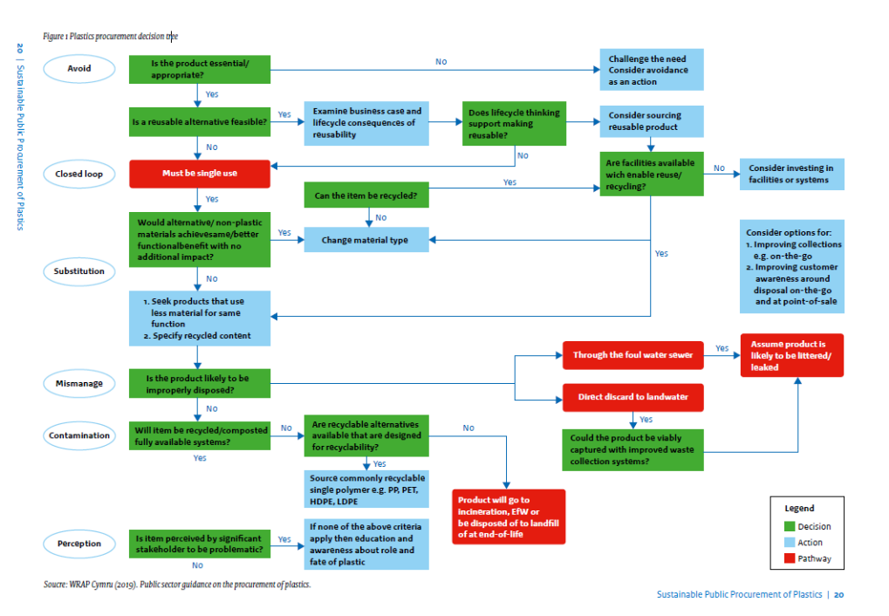
Resource
Making the right decisions early (again)
Source: Sustainable Public Procurement of Plastics (oneplanetnetwork.org)
Notes:
This slide introduces a more detailed decision flow chart considering how plastics waste may be reduced through early consideration of options – including the link to waste management infrastructure – which is an essential element where recycling is the practical option.
It is an example of an approach to get delegates thinking about options.

Slide 46
Trainer tips
Jo-Anne –
this Section is a little more complicated in terms of suggested timings:
Slides 37-38: 10 minutes (including questions)
Lunch break: 30 minutes
Break out and brief plenary: 20 minutes
Slides 41-43: 15 minutes
Resource slides – these are hidden but you can show them and/or refer to them as additional resources for learning outside of the Module training.
  Reference the resource materials website if you do.
  Note the more detailed plastic strategies can be mentioned as part of the additional resources.
  Note the more detailed plastics procurement decision tree can be referenced as a tool within the additional resources.
Timings – this section should take around 45 minutes and an additional 30 minutes for short lunch break
  Note that lunch break can be flexed in trainings sessions depending on the audience but a minimum 10 minute comfort break around the middle is recommended.

Slide 47

A. The Circular economy and plastics
B. Circular procurement and plastics
C. Addressing the plastics challenge
D. Defining actions
Notes:
Having considered the role of procurement in reducing plastics waste through circular approaches and addressing challenges to this, we need to consider relevant action that delegates may take forward.

Slide 48
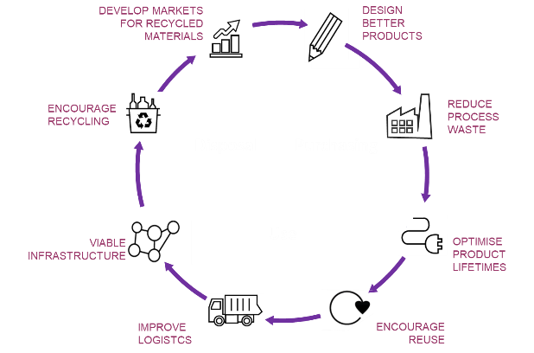
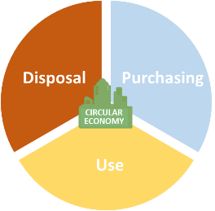








Choosing a starting point
Are you looking to make a step change or a transformational change?
Be proportionate to the size (£) and the subject matter of the tender.
Where to start?
Starting point will determine what tools can be considered.
Notes:
As introduction to next session:
Being a cycle there are any number of areas that a circular procurement approach can influence.
So depends on what the aim / ambition is for this tender / product / spend area – and what is achievable (for example focussing on lifetime extension for ICT rather than design given the global supply for electronics).
Can you adopt a transformational approach – influencing all the aspects of the product lifecycle (e.g. potentially within buildings)
Or a more targeted approach e.g. focussing on sourcing, or on how products used (e.g. servicisation) or how they may be reused (e.g. furniture or ICT)
Need to balance aims with the size and subject matter (Be Proportionate).

Slide 49

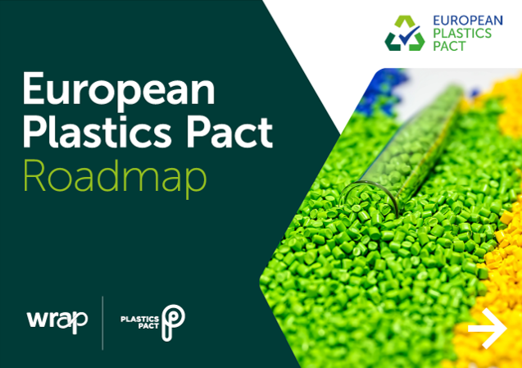
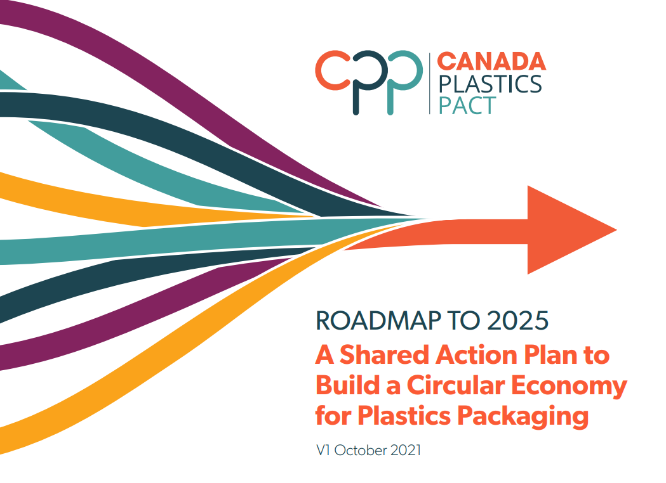
A road map to reduce plastics waste
Step 1: Understand what you currently purchase
Step 2: Understand how plastic products and packaging are used and disposed of
Step 3: Identify options to avoid, re-use or replace plastics
Step 4: Use buying power
Step 5: Guidance and communication to support behavior change
Step 6: Monitor and evaluate the impact of changes
Step 7: Encourage suppliers to apply the principles and practice of the Canada-wide Strategy on Zero Plastic Waste and Action Plan…
Modified from: https://wrapcymru.org.uk/sites/default/files/2020-09/WRAP-procurement-guidance-2019.pdf
Notes:
This is based on European Plastics Pact Road Map.
Stress that this session has considered 1, 2, 3 and 4. These will be considered further in the next session as well as relevant guidance (5).
It is essential that lessons learned from this training are cascaded to colleagues – it is also vital that outcomes from changes to procurements which focus on plastics waste reduction are captured and monitored – a track and reporting mechanism against ambitions.
Working with suppliers and markets is also vital to encourage and enable meaningful change – a two-way dialogue is important. Make it clear to markets and suppliers what your ambitions / requirements are/ how relevant this is to them and also understand market capability and capacity to support plastics waste reduction.
Canada Plastics Pact:
1 plastics packaging represents nearly 50% of the plastics produced in Canada each year;
2 after it’s short first-use cycle, an estimated 95% of plastics packaging material value is lost;
3 there is both a clear path and momentum from key businesses, governments and organizations across Canada for addressing the challenge of plastics packaging.
4 targets:
Define a list of plastic packaging that is to be designated as problematic or unnecessary and take measures to eliminate them by 2025.
Support efforts towards 100% of plastic packaging being designed to be reusable, recyclable or compostable by 2025.
Undertake ambitious actions to ensure that at least 50% of plastic packaging is effectively recycled or composted by 2025.
Ensure an average of at least 30% recycled content across all plastic packaging (by weight) by 2025.

Slide 50
Suggest 15 -20 minutes for this exercise
Developing an Action Plan
ACTION | FOCUS e.g. Policy and Buy-in, Capability, Collaboration, Identifying priorities, Tender requirements, Monitoring outcomes | KEY ACTORS
Breakout Groups
Notes:
In groups facilitate discussion about:
What are the key actions they feel need to take place?
Who are the internal and external functions or roles that are critical and how can we address their focus areas.
Use the heat map (Canadian HeatMap report) and ask participants to use the ambitions chart to identify 3 or 4 critical buying category to reduce plastic by identifying what CE business models could be leveraged.
Ask them to feedback key actions (as a group) using the template on the slide and how they may vary within the group according to the organisation/ region?
Does this include opportunities to collaborate in the future among the group?
Allow time for discussion
Action Plan template included in Resources Pack.

Slide 51

SESSION 1 LEARNING CHECKLIST – Key takeaways
1. Circular economy, procurement and plastics
Aim:
Create a common understanding of the benefits and key principles of circular procurement relating to plastics waste.
How it supports priority economic, environmental and social outcomes at Federal, Provincial or Municipal level.
Identify key actions/ next steps at policy/ strategy/ process/ capability or other level.
I understand:
…the important role that procurement plays in addressing the climate emergency and supporting a circular economy and benefits arising.
…where and how plastics waste arises and the nature of the problem.
…procurement success factors of setting clear ambition, asking ‘Why’ to consider alternatives, collaborating internally, with markets and peers – early in the process.
…challenges to reducing plastics waste through procurement and actual or potential solutions.
…key questions to ask and where to focus effort to start to address plastics waste through procurement.
Discussion
Notes:
Ask whether any uncertainties remain – can they tick all of the above?

Slide 52
Next session….specifying requirements - asking the right questions
Next session….specifying requirements - asking the right questions
2. Specifying circular outcomes – the procurement toolbox
Aims:
Build confidence in practically using procurement to reduce plastic waste.
Apply through stages of the procurement process and the life cycle of the relevant product/ service or works.
Identify key actions/ next steps for procurement project/ policy/ strategy/ process/ capability or other level.
Before the next session consider:
Planned procurements, where plastics is used/ plastics waste is an issue of concern
Notes:
Introduce next session – focus will be on specifying for plastics waste reduction. This includes
Aim: Understanding how outcomes based questions can be for a specific product group, according to the complexity of a product group, the maturity of the market.

Slide 53

Give us some feedback…….
Poll
Thank you!
Notes:
ON LINE EVALUATION POLL TO BE COMPLETED IN THE SESSION

Slide 54
Trainer tips
Feedback on:
  Level of content (too detailed/ not enough detail)
  Pace
Timings may be pressed at the end of Module but ensure that the Action Plan Breakout group is given adequate time (minimum of 15 minutes recommended).
Timings – this section should take around 25 minutes including Action Plan and Module closure
Total Module including 30 minute lunch break is 3 hours.

Slide 55

CONTACTS:
Jo-Anne St. Godard, Circular Innovation Council
joanne@circularinnovation.ca
Mervyn Jones, Sustainable Global Resources
mervyn@sustainableglobalresources.co.uk
TRAINING WEBSITE: https://circularplastics.eu/green_procurement
SESSION 2 - Specifying circular outcomes – the procurement toolbox is on 2 December 2022
Training materials developed by Sustainable Procurement Limited www.sustainableprocurement.eu.com

Slide 56
